Slide 1
Computer Organization and Assembly language
Members
Muhammad Zohaib Malik
Muhammad Zain
Zaryab Akbar

Slide 2
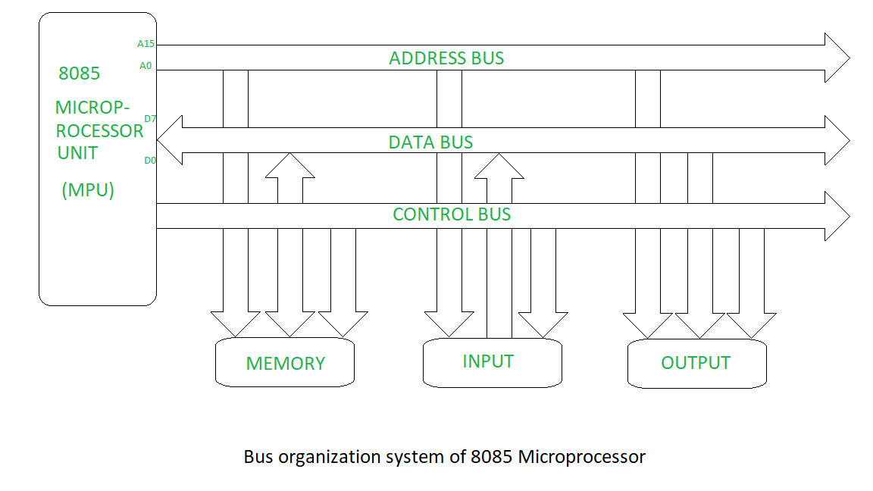
High Performance Bus Organization

Slide 3
Element of Bus Design
Types of buses
Dedicated Bus
Multiplexed Bus

Slide 4
Dedicated Bus
A dedicated bus is permanently assigned either to a particular function or to a physical subset of computer components.
Particular Function
Particular Function means a separate bus for each
different functions.
Example
Address bus ,Data bus, Control bus

Slide 5
Physical Subset
Physical Subset use to separate buses connecting different system component having same functionality.
Example
Input/output devices and Memory.
Advantage
High Throughput.
Disadvantage
High cost, high size.

Slide 6
Multiplexed Bus
Multiplexed Bus used a common bus for both data and address transmission.
Presence of a control line in which address valid signal travel.
Working?
Activate valid address signal line.
Places address on multiplexed line.
Modules check if the address refer them.
After sometime, address removed and data is sent on bus.
Advantage
Less cost, use of few lines.
Disadvantage
Reduced performance ,More complex circuit.

Slide 7
Method of Arbitration in a Bus
Method of Arbitration in a Bus is used to decide which component
Can transmit over bus, when multiple components wants to gain control of the bus.
Centralized.
Distributed.

Slide 8
Centralized
A single hardware device allocates time and control of bus to other devices
It may be separate module are a part of processor.
Distributed
No central authority.
Each module has a code for access control and module act together to share the bus.

Slide 9
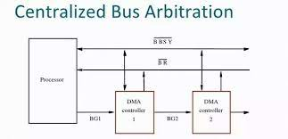

Slide 10
Bus Timing
Bus timing refer to the way of event are carried out on the bus.
Synchronous
Asynchronous

Slide 11

Synchronous
The System clock determines the occurrence of event on bus..
Bus has a clock line on which continuous of alternating 0 and 1 is transmitted by clock having equal duration.
All event start at the beginning of clock cycle.

Slide 12
Asynchronous
There is no clock.
Occurrence of 1 event on bus follows and depend on the occurrence of the previous event on bus.
Asynchronous buses are often used in situations where devices have varying processing capabilities.

Slide 13
CPU Architecture
CISC
CISC stands for Complex Instruction Set Computer.
Large Number of Instructions.
variable-length instruction.
High Cost.
Manipulating data directly in memory.
RISC
RISC stands for Reduced Instruction Set Computer.
Less Number of Instructions.
Fixed variable-length instructions.
Less Cost.
Only in Registers.

